Slide 1
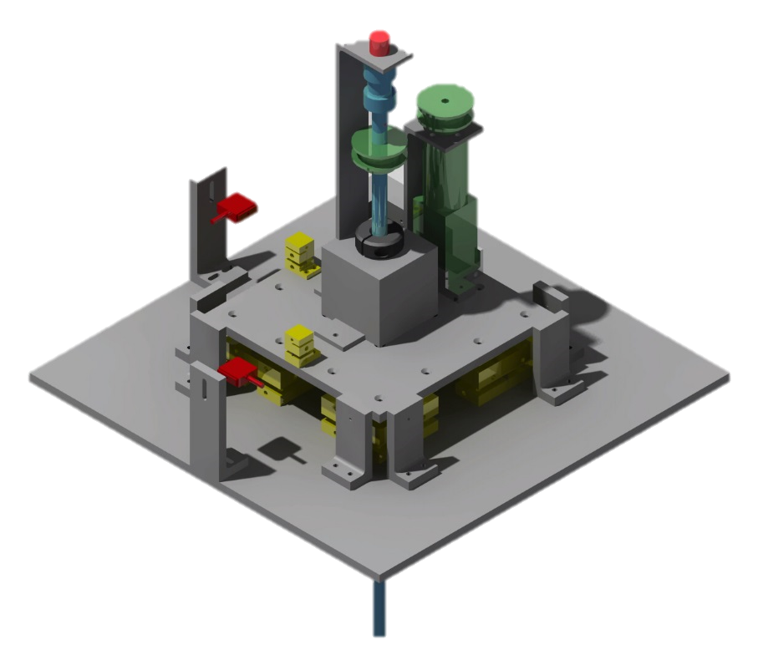

Low-Range Force Balance Research Project
By:
Cody Johnson
Arizona Space Grant Consortium, Phoenix, AZ
April 21-22, 2017

Slide 2
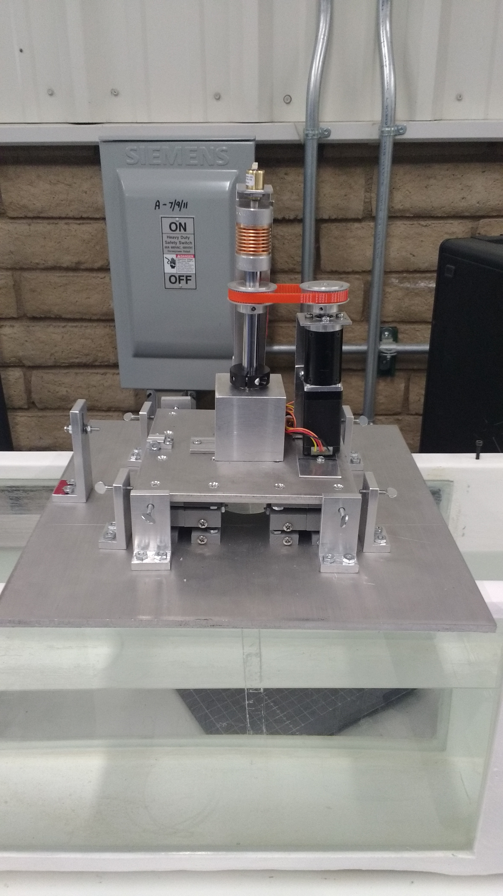
What is a Force Balance?
Supports test specimen
Transmits loads
Measures forces

Slide 3
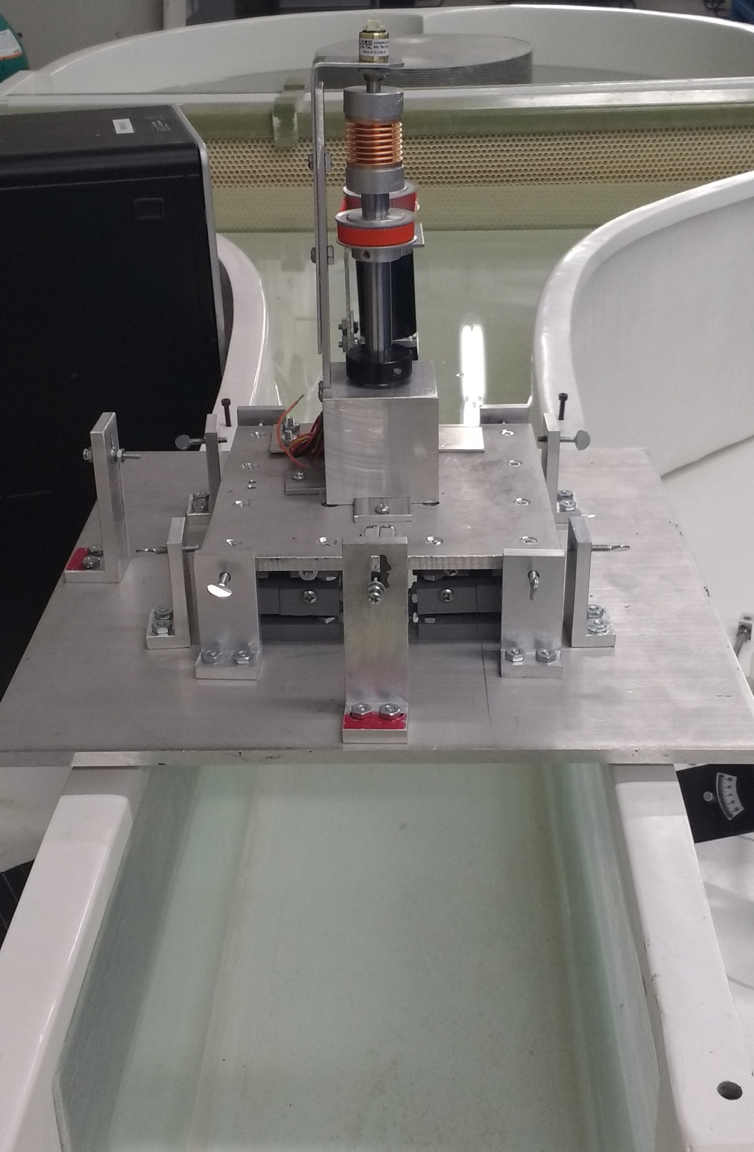
Project Objective
Allow low Reynold’s number research
  Micro-drones
  Viscous flow effects

Slide 4
Project Requirements
Capture small forces
Record various angle of attacks

Slide 5
Project Constraints
Forces not to exceed 50 grams
Only record forces in two axis
No moments

Slide 6
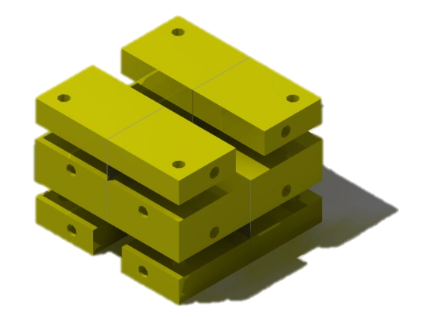
Requirements
Capture small forces
  Vertical support
  Allow for horizontal translation
  Low range load cells

Slide 7
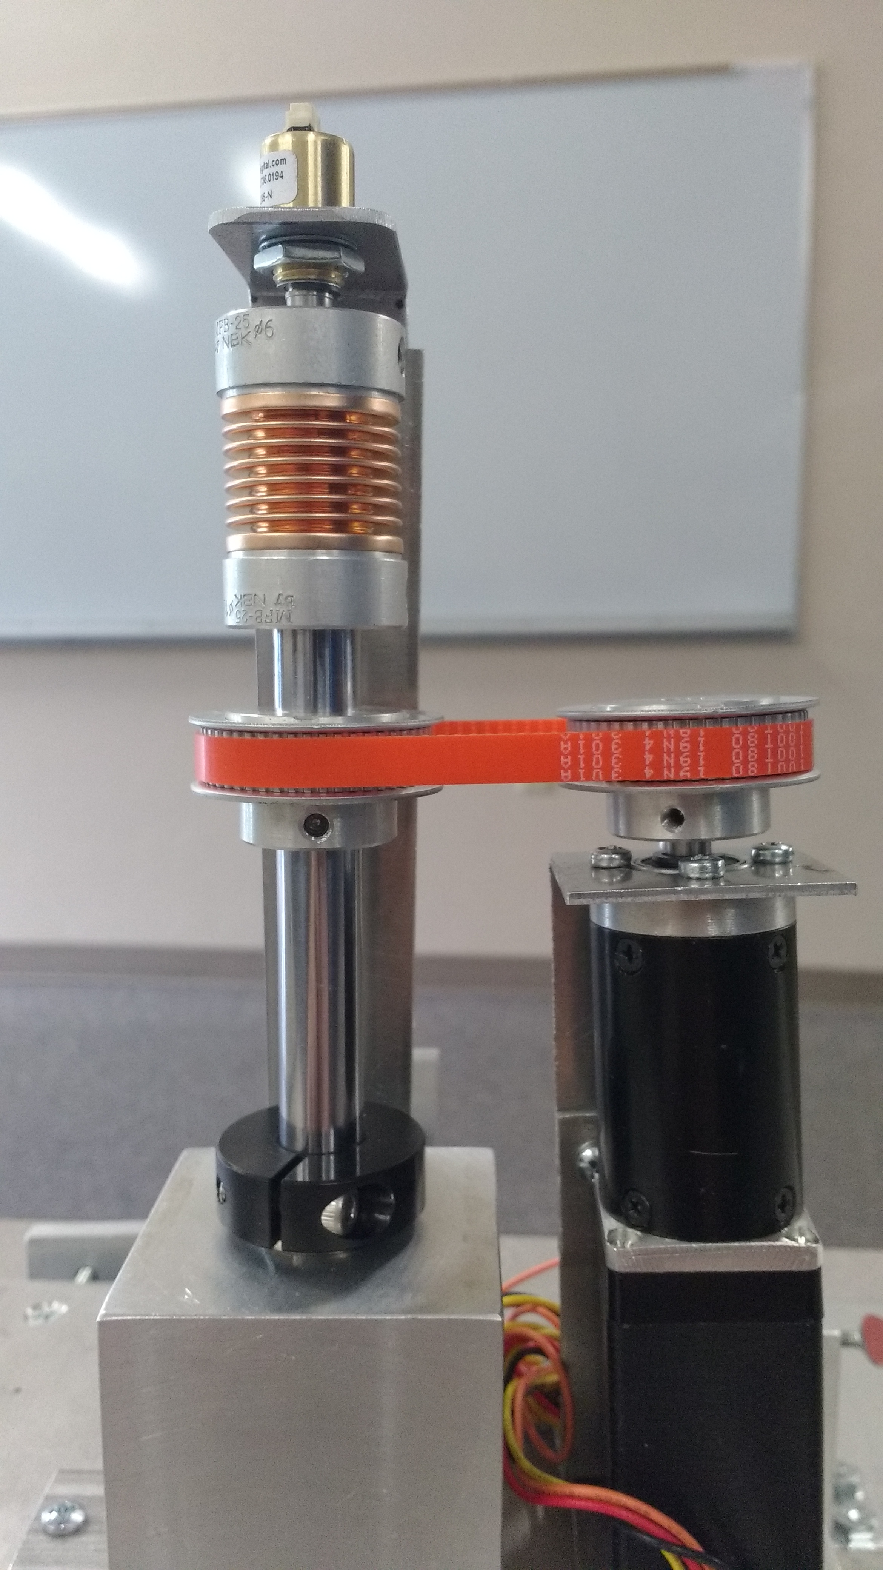
Requirements
Various angles of attack
  Digital encoder
  Stepper motor
  Rotating mount
Digital Encoder
Stepper motor
Rotating Mount

Slide 8
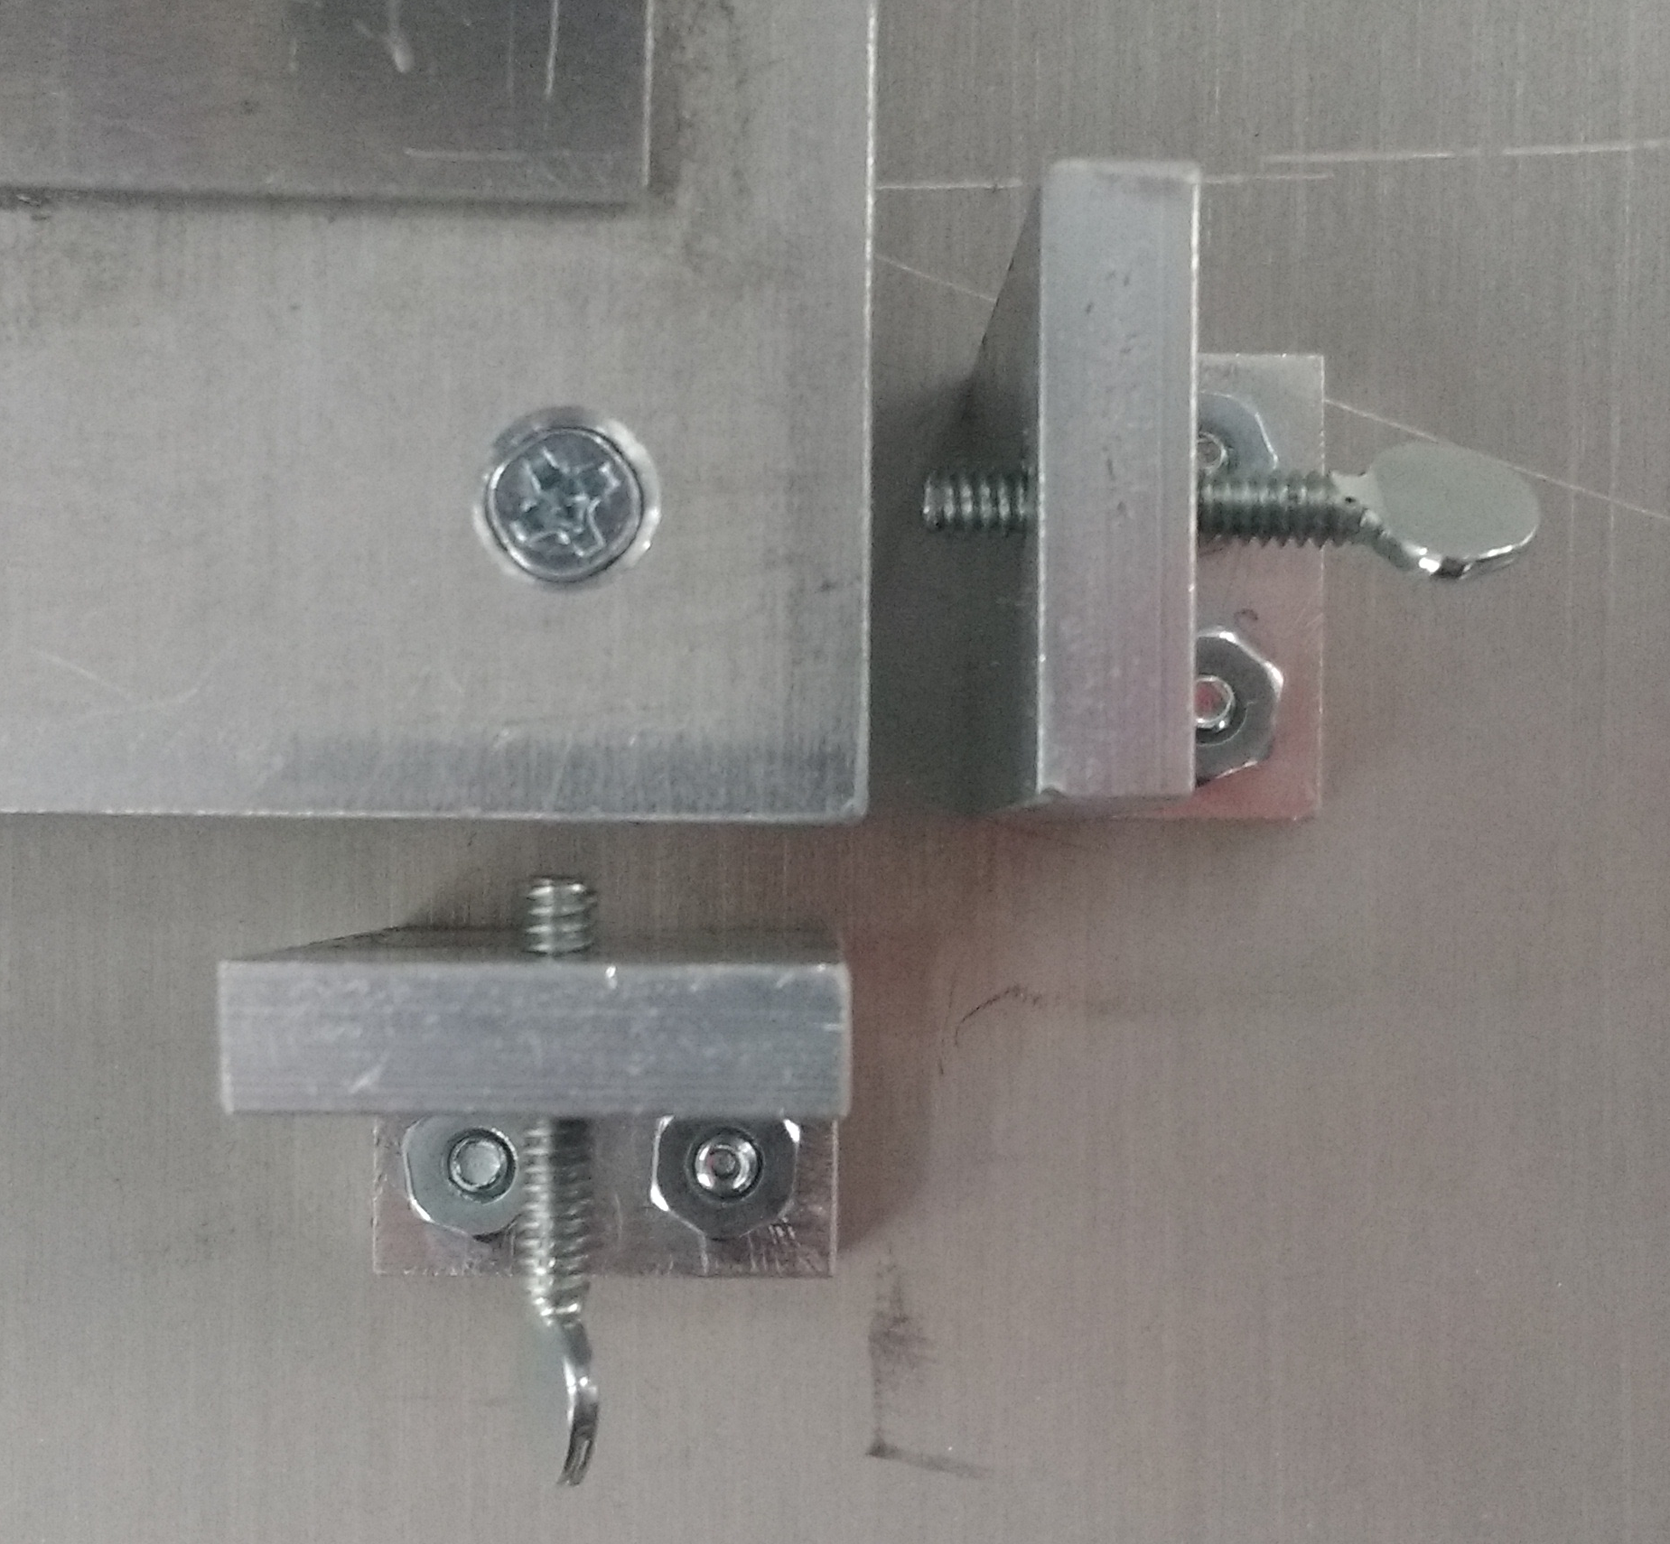
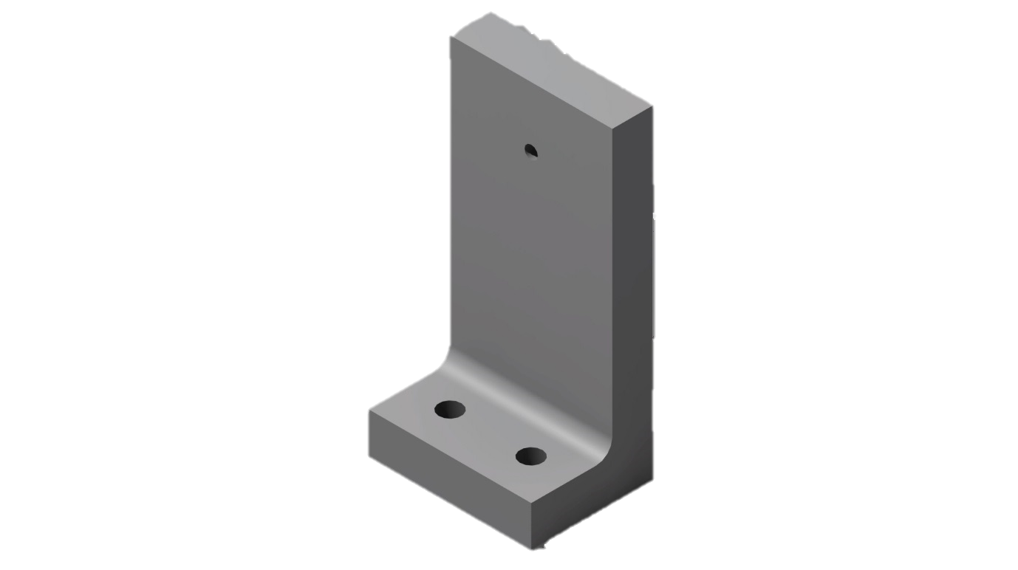
Load Cell Protection
Support towers to allow for transportation

Slide 9
Special Thanks
Dr. Lance Traub
  Mentor for this project
Mr. Patrick David
  ERAU Prescott Machinist
James McClure
  Balance concept

Slide 10
Questions?

